Slide 1
Chapter 5
Ethics and Social Responsibility

Slide 2
Should I pay a bribe to a foreign official, if that bribe will result in obtaining permission to implement a health care system for the poor in a developing country?

Slide 3
What is Ethics?
Definition
  Code of moral principles and values that
  Govern behavior of individuals and organizations
  With respect to what is right or wrong
Codified law at one end and free will at the other
Ethics lie between the two extremes
  Law – written code of values Enforced by society in courts
  Free will- established code of ethics by the individual
  Ethics – the space in between is based on shared values of the organization and the people in it.
  Room for disagreement within broad value systems

Slide 4
Normative Ethics-How do you make an Ethical Decision?
Exists between the areas of law where behavior is prescribed and free will where anything goes.
A way of describing various approaches to ethical behavior based on norms of behavior.
Norm is a standard of behavior
Decisions are made by comparing the proposed action against the norm

Slide 5
Normative Ethics-How do you make an Ethical Decision?
There is frequently wiggle room so whatever fits best compared with the norm, wins

Slide 6
Implications of Normative Ethics
If the norms of ethical behavior are established by the members of the organization, and they fit between law and free will, can an organization’s norms of ethical behavior be unethical?
Is there an absolute value system?

Slide 7
Ethics and leadership
Normative ethics
  The space between codified law and free will.
  Codified law
  Free will
Ethical Theories
  Consequentialism (teleological)
  Deontological.
  Virtue-based

Slide 8
Normative Ethics
There is no overriding ethical value system upon which all ethical decisions are based.
Ethical decisions are based on norms of behavior established by society.
Some of these norms are codified into law for which society exacts a penalty for violation.
At the other end, are norms that the individual is free to modify or ignore.
In between these two extremes are ethics and evolve within societies, to guide the behavior of its citizens.
People make decisions, as best they can, to fit within this ethical space between law and free will.

Slide 9
How do we make normative ethical decisions?
Ethical theories
Ethics of conduct
Consequentialism
Deontology
Ethics of character
Aristotle
Ethical egoism
Utilitarianism
Altruism

Slide 10
Consequentialism
Teleological moral systems are characterized primarily by a focus on consequences.
The right action is the one that produces the most intrinsic good.
  For oneself-ethical egoism-earmarks attached to legislation.
  For the most people-utilitarianism-health-care reform.
  For others-altruism-Mother Theresa

Slide 11
Deontology
Deontological moral systems are characterized primarily by a focus upon adherence to an independent moral rules or duties.
Good is defined as inherently right, independent of consequences.
  Tell the truth, keep your promises, respect others,

Slide 12
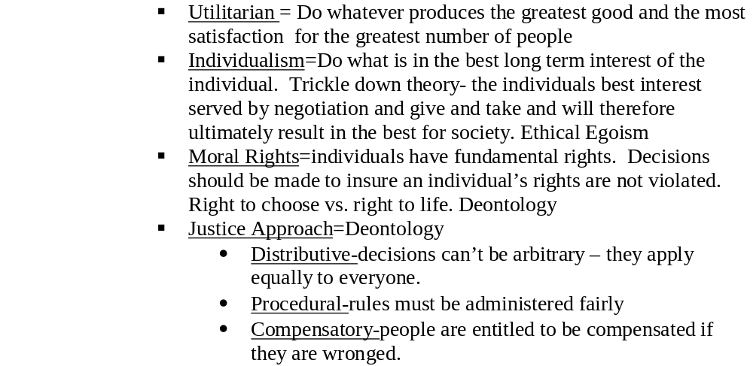
Some Decision Rules for making ethical decisions:

Slide 13
Decisions based on the ethics of conduct, answer the question “what should I do.”
Ethical theories
Ethics of conduct
Consequentialism
Deontology
Ethics of character
Aristotle
Ethical egoism
Utilitarianism
Altruism

Slide 14
Ethics of character
What sort of person should I become?
An action is right, if it is what a virtuous agent would do in the circumstances.
Virtue-based ethical theories emphasize helping people develop good character traits such as kindness and generosity.
A kind and generous person will make the right decision.

Slide 15
Should I pay a bribe to a foreign official, if that bribe will result in obtaining permission to implement a health care system for the poor in a developing country?

Slide 16
It depends?
Utilitarian theory
  Yes, it will result in the most good for the most people.
Ethical egoism.
  Not really, since I’m not getting anything out of it.
Altruism
  Yes, it will result in the most good for other people.
Deontology
  No, paying a bribe is inherently wrong. It violates the rules and should not be done.
Virtue-based ethics.
  No, a virtuous person would not pay a bribe. His nature would not allow it.

Slide 17
Factors that affect ethical choices
The Manager
The Organization

Slide 18
Factors that affect ethical choices
The Manager
  Brings specific set of values to the game
  Based on Personal needs, family influence, religious background, cultural background
  The moral stage of development
    Preconventional level-External rewards and punishment
    Conventional Level- external expectations of colleagues, friends and family
    Post Conventional-internal standards and values

Slide 19
Three Categories of Management Morality
Moral manager
Managerial ethical and moral principles
Immoral manager
Amoral manager

Slide 20

Characteristics of a Moral Manager
Dedicated to high standards of ethical behavior in
  Own actions
  How the company’s business is to be conducted
Considers it important to
  Be a steward of ethical behavior
  Demonstrate ethical leadership
Pursues business success
  Within confines of both letter and spirit of laws
  With a habit of operating well above what laws require

Slide 21
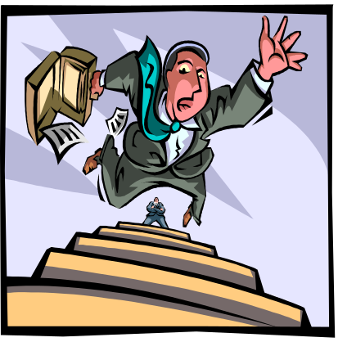
Characteristics of an Immoral Manager
Actively opposes ethical behavior in business
Willfully ignores ethical principles in making decisions
Views legal standards as barriers to overcome
Pursues own self-interests
Is an example of capitalistic greed
Ignores interests of others
Focuses only on bottom line – making one’s numbers
Will trample on others to avoid being trampled upon

Slide 22
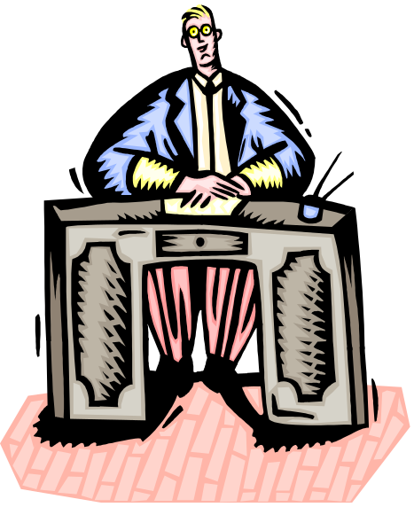
Characteristics of an Intentionally Amoral Manager
Believes business and ethics should not be mixed since different rules apply to
  Business activities
  Other realms of life
Does not factor ethical considerations into
own actions since business activity lies
outside sphere of moral judgment
Views ethics as inappropriate for
tough, competitive business world
Concept of right and wrong is lawyer-driven (what can we get by with without running afoul of the law)

Slide 23
Characteristics of an Unintentionally Amoral Manager
Is blind to or casual about ethics of
decision-making and business actions
Displays lack of concern regarding
whether ethics applies to company actions
Sees self as well-intentioned or personally ethical
Typical beliefs
  Do what is necessary to comply with laws and regulations
  Government provides legal framework stating what society will put up with—if it is not illegal, it is allowed

Slide 24
Factors that affect ethical choices
The Organization
  Explicit Rules-no bribes
  Reward System-Don’t incentivize immoral behavior
  The selection system-who you pick to be in the organization
  Ethical and professional standards
  Leadership

Slide 25

What Are the Drivers of Unethical Strategies and Business Behavior?
The large numbers of immoral and amoral business people. Overzealous pursuit of personal gain, wealth, and other selfish interests. People obsessed with wealth accumulation, greed, power, and status often
Heavy pressures on company managers
to meet or beat earnings targets Managers often feel enormous pressure to do whatever it takes to deliver good financial performance
A company culture that places profits and
good performance ahead of ethical behavior

Slide 26
Company Culture Places Profits and Good Performance Ahead of Ethical Behavior
In an ethically corrupt or amoral work climate,
people have a company-approved license to
  Ignore “what’s right”
  Engage in most any behavior or employ most
  any strategy they think they can get away with
  Play down the relevance of ethical strategic
  actions and business conduct
Pressures to conform to the norms of the corporate culture can prompt otherwise honorable people to
  Make ethical mistakes
  Succumb to the many opportunities around them to engage in unethical practices

Slide 27

Business Ethics in the Global Community
Notions of right and wrong, fair and unfair, moral and immoral, ethical and unethical exist in all societies
Two schools of thought
  Ethical universalism
    Holds that human nature is the same everywhere
    and ethical rules are cross-cultural
  Ethical relativism
    Holds that different societal cultures and
    customs give rise to divergent values and
    ethical principles of right and wrong

Slide 28


Cross-Culture Variability in Ethical Standards
Apart from certain universal basics –
  Honesty
  Trustworthiness
  Fairness
  Avoiding unnecessary harm
  Respecting the environment –
variations exist in what societies generally agree to be
right and wrong in the conduct of business activities
Factors affecting cross-cultural variability
  Religious beliefs
  Historic traditions
  Social customs
  Prevailing political and economic doctrines
Cross-country variations also exist in the degree to which certain behaviors are considered unethical

Slide 29

Ethical vs. Unethical Conduct
What constitutes ethical or unethical
conduct can vary according to
  Time
  Circumstance
  Local cultural norms
  Religion
Thus, no objective way exists to prove that some cultures are correct and others wrong about proper business ethics
Therefore, there is merit in the ethical relativism view that proper business ethics has to be viewed in the context of each country’s societal norms

Slide 30
Social Responsibility
Social Responsibility is management’s obligation to make choices that will contribute to the welfare and interests of society as well as to the well being of the organization.

Slide 31
Social Responsibility
Difficult to accomplish-subjective criteria
Great idea in concept but stakeholders interests conflict, making specific decisions controversial

Slide 32
Social Responsibility
Stakeholders and their Expectations
An organizational stakeholder is any group, inside or outside the company, that has an stake in the organization’s performance
Stakeholders and their expectations
  Employees-salary, security, benefits
  Investors – profits and return on their investments
  Customers- quality, availability, price, safety,
  Government- taxes, employment, give back to the community
  Suppliers – expect to get paid on time, loyalty
  Consumers – maintain the environment

Slide 33
Criteria for Corporate social performance
Ways that social responsibility can be evaluated.
  Economic
    Companies have a social responsibility to make a profit and survive
  Legal
    A responsibility to achieve economic goals within the various federal, state, local laws.
  Ethical
    A responsibility to develop a set of ethical standards and stick to them.
  Discretionary
    Go the extra mile; no payback expected;

Slide 34
How corporation respond to Social Demands
Obstructive - Phillip Morris
  We did nothing wrong
Defensive – Firestone
  We operate entirely within the law and the law protects us.
Accomodative-Tylenol
  When things go wrong, we are responsible for making it right-even if it isn’t our fault
Proactive-Ben and Jerry’s Ice Cream

Slide 35
Is Ethics and Social Responsibility Expensive?

